Slide 1




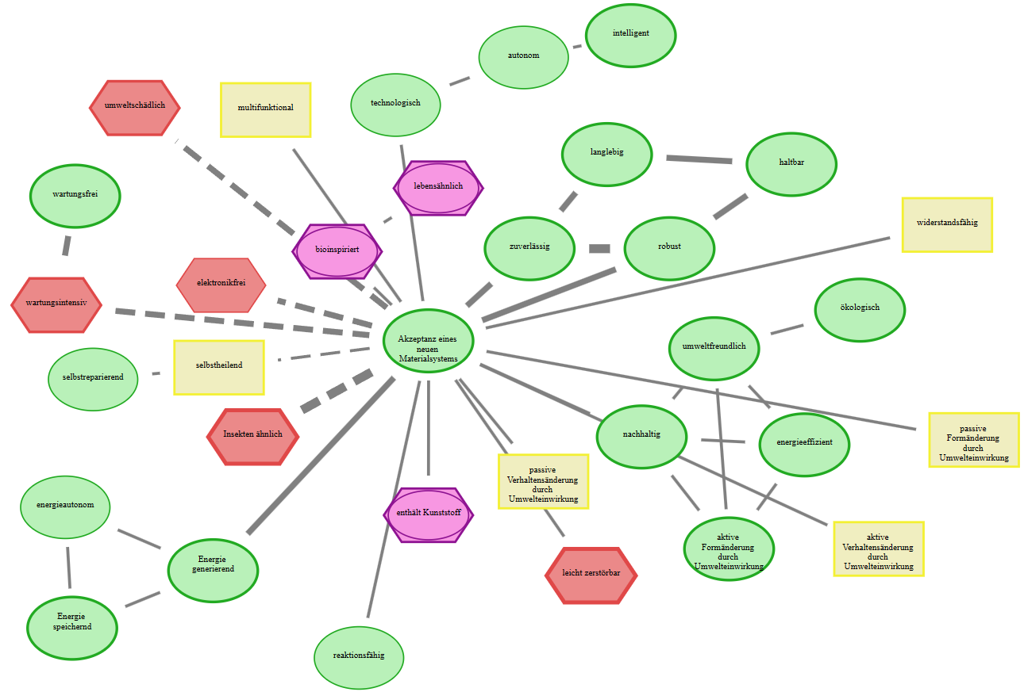
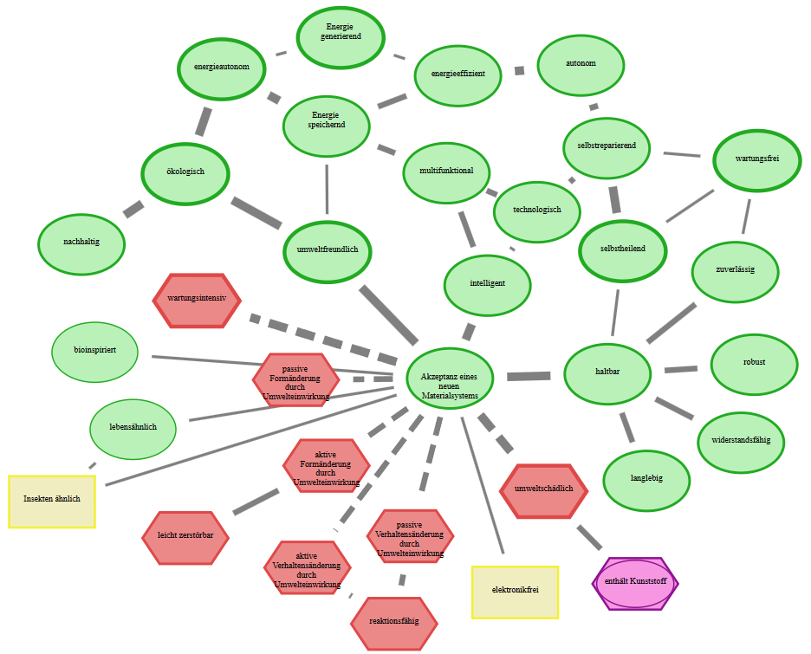
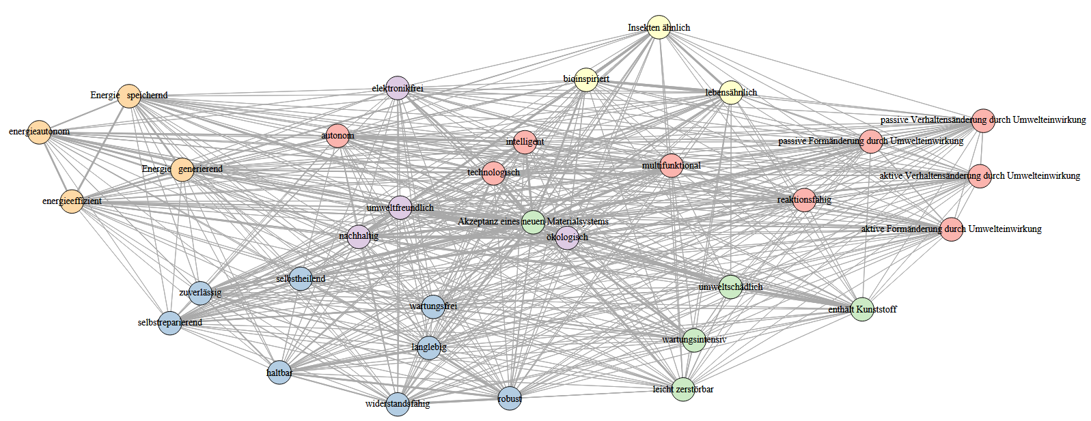
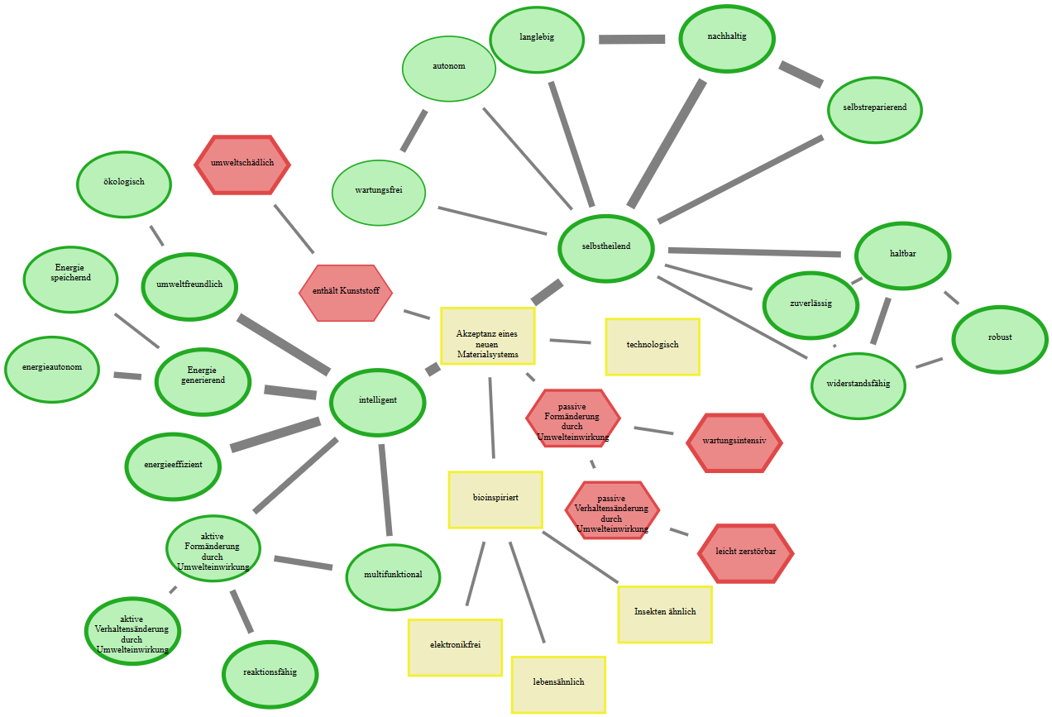
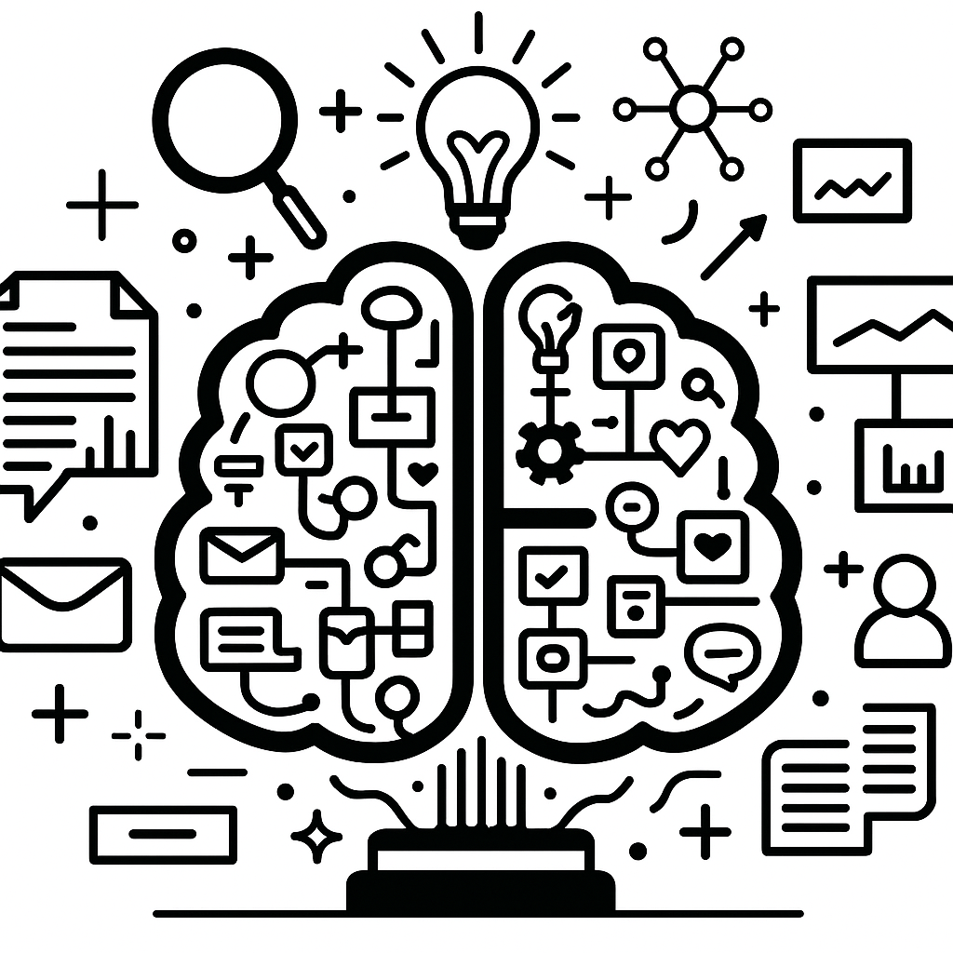
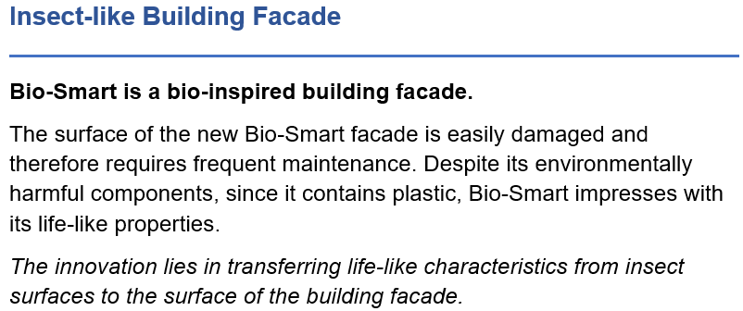
Part I: create a list of basal attributes
(a) Conducted 14 guided expert interviews to create an initial list of basal attributes
(c) Got ratings of 21 experts for (a) the relevance of remaining basal attributes and (b) possible missing's
(b) Reduced initial lists by three raters
(d) Automatically scanned all livMatS for possible relevant adjectives using part-of-speech tagging
Part II: Cognitive-Affective Maps study
Applied analyses on different levels of the CAMs, using especially community detection algorithms
Identified clusters of basal attributes surrounding the central concept
Conducted a large-scale CAM study (N=192) to assess lay perceptions.
Part III: proof of concepts - textual descriptions of identified clusters
Conducted large-scale study (N=298) assessing lay perceptions of six material system descriptions across usefulness, trustworthiness, usage intention, and emotional response.
LLM-assisted generation of expert-refined scenarios for future material systems using attribute clusters.
Scenario 1 (Cluster 3+6)

